Slide 1
VLSI (MOS Fabrication)
Lecture-04

Slide 2
MOS Fabrication
There are a large number and variety of basic fabrication steps used in the production of modern MOS ICs. The same process can be used for the designed of NMOS or PMOS or CMOS devices. The gate material could be either metal or poly-silicon . The most commonly used substrate is bulk silicon or silicon-on-sapphire (SOS).
Substrate, body or bulk
NMOS Transistor

Slide 3
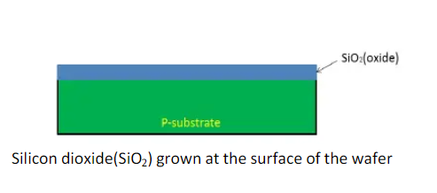
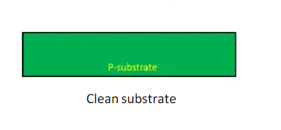
NMOS Fabrication
Step-1: Processing is carried on single crystal silicon of high purity on which required Impurities are introduced as crystal is grown.
Step-2: A layer of silicon dioxide (SiO2) typically 1 micrometer thick is grown all over the surface of the wafer to protect the surface.

Slide 4
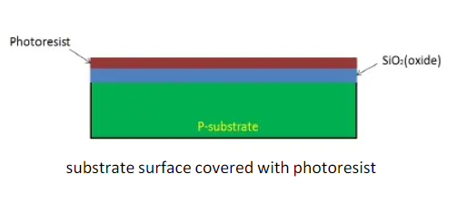
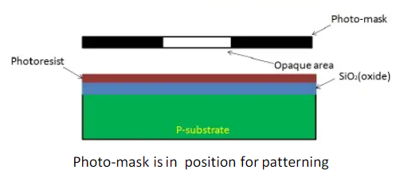
NMOS Fabrication
Step-3: The surface is now covered with the photoresist which is deposited onto the wafer and spun to an even distribution of the required thickness.
Step-4: The photo resist layer is then exposed to ultraviolet light through masking which defines those regions into which diffusion is to take place together with transistor channels.

Slide 5
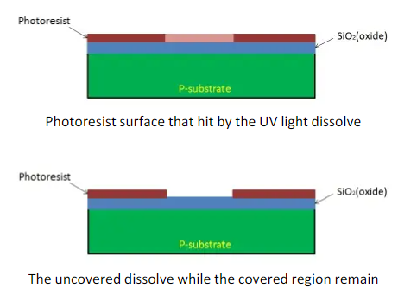
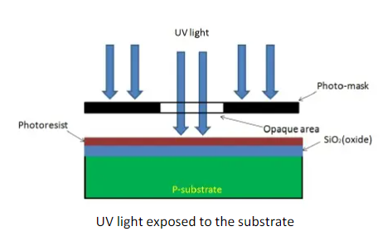
NMOS Fabrication
Step-4:

Slide 6
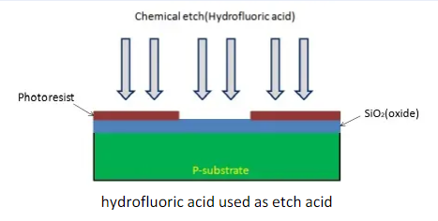
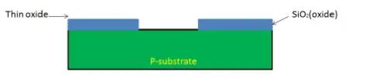
NMOS Fabrication
Step-5 (a): The substrate now is ready to be etched to remove the remaining photoresist at the substrate and to create an opening at the substrate.
Step-5 (b): The remaining photoresist removed and an opening to the substrate created.

Slide 7
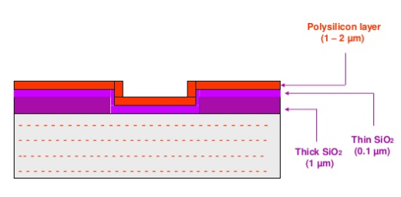
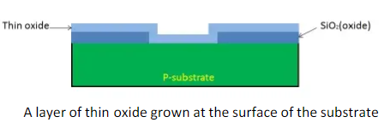
NMOS Fabrication
Step-6: A layer of the thin oxide is form SiO2 (0.1 micrometer typical) is grown over the entire chip surface at high temperature.
Step-7: A thin layer of polysilicon is grown all over the entire chip surface of the wafer to from the gate.

Slide 8
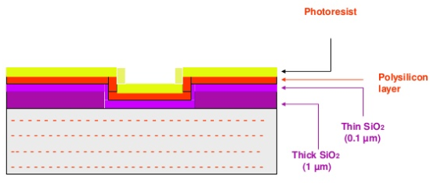
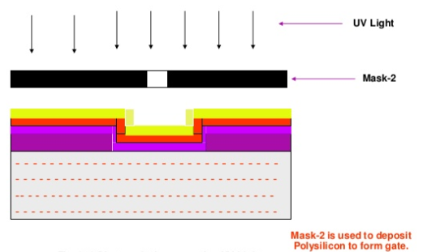
NMOS Fabrication
Step-8: A layer of photoresist is grown over the polysilicon layer.
Step-9: Use same lithographic process to pattern polysilicon. Photoresist is exposed to UV light.

Slide 9
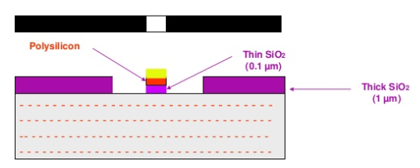
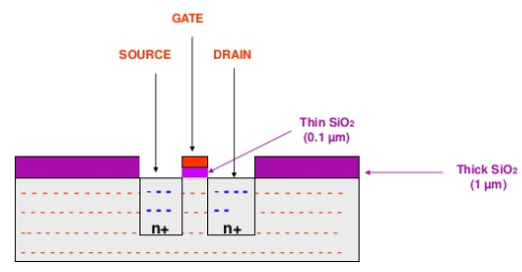
NMOS Fabrication
Step-10: Etching will remove the portion of thin SiO2 which is not exposed to UV light.
Step-11: Now diffuse n+ dopants and forms n+ regions. n+ doping to form SOURCE and DRAIN.

Slide 10
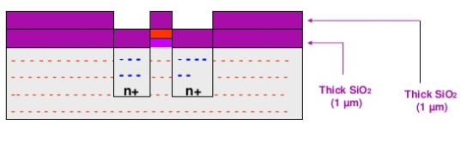
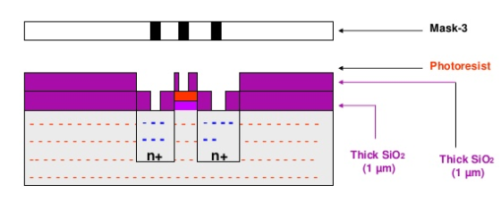
NMOS Fabrication
Step-12: A thick layer of SiO2 is again grown.
Step-13: To get metallic contact we need to add another SiO2 layer. The contact cuts are formed for S, D and G.

Slide 11
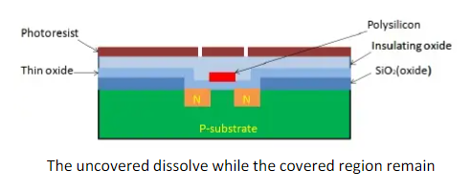
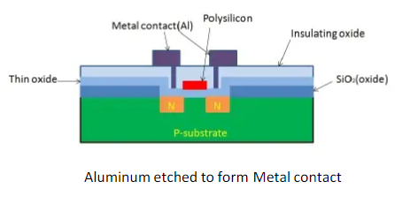
NMOS Fabrication
Step-14: Now we need to wire together the devices. Cover the chip with the field oxide.
Step-15: Now for metallization sputter on aluminum over whole wafer pattern to remove excess metal, leaving wires.

Slide 12
NMOS Fabrication
Step-16: This metal layer is then masked and etched to form the required interconnection pattern.
NMOS Transistor

